Slide 1


The Benefits of Women in Energy Forum for the Organisation
Khayakazi Dioka
CIGRE WiE International Chair 2018-2022
South Africa
© CIGRE 2021

Slide 2




























CIGRE Women in Energy Background
Founded in 2014 by Dr Ruomei Li, to increase active participation of women at CIGRE
Several Forums every Paris Session + Centennial Session.
Women engineer role modelling, mentorship, leaders emerged, different topics discussed.
National Committees with WiE Forums increased, so did women members and active participation
Introduced WiE award in 2021
29 National Committees - International Executive Committee
Australia Brazil Bosnia & Herzegovina Canada China
Colombia Croatia France GCC Germany Spain
India Iran Israel Italy Japan Kosovo
Netherlands New Zealand Romania Russia Slovenia Ukraine
South Africa Sweden Turkey United Kingdom USA

Slide 3
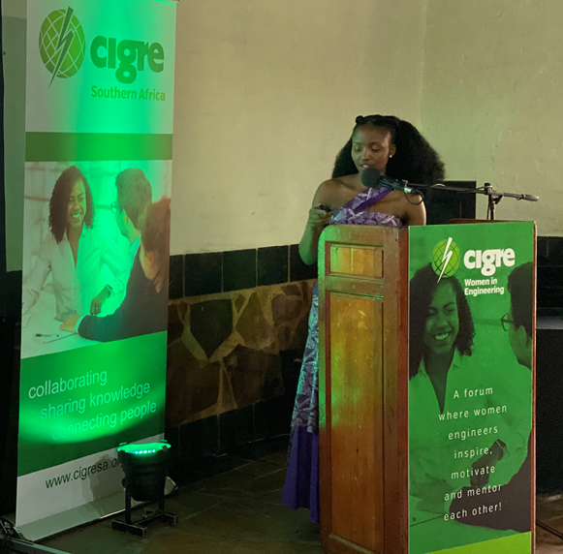
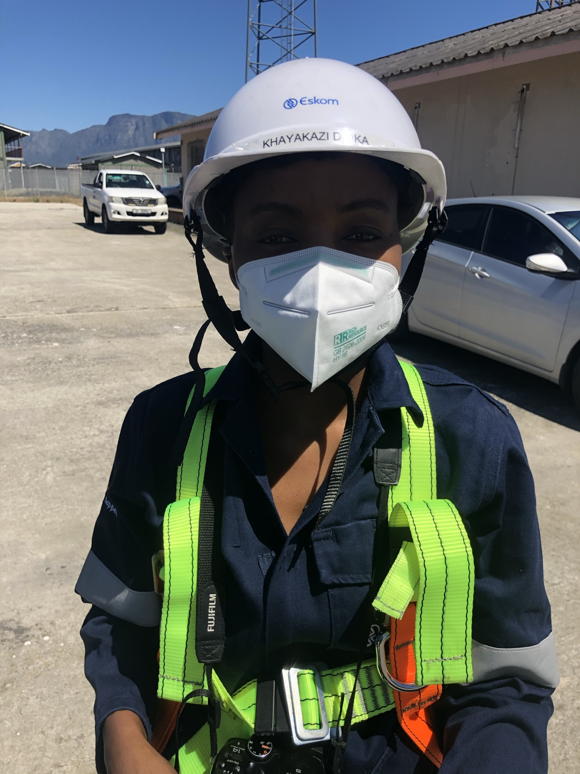
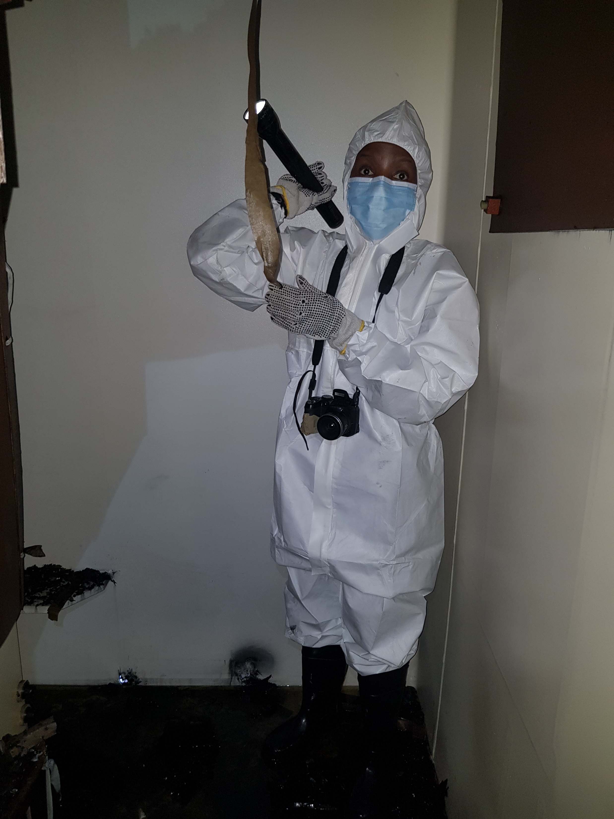
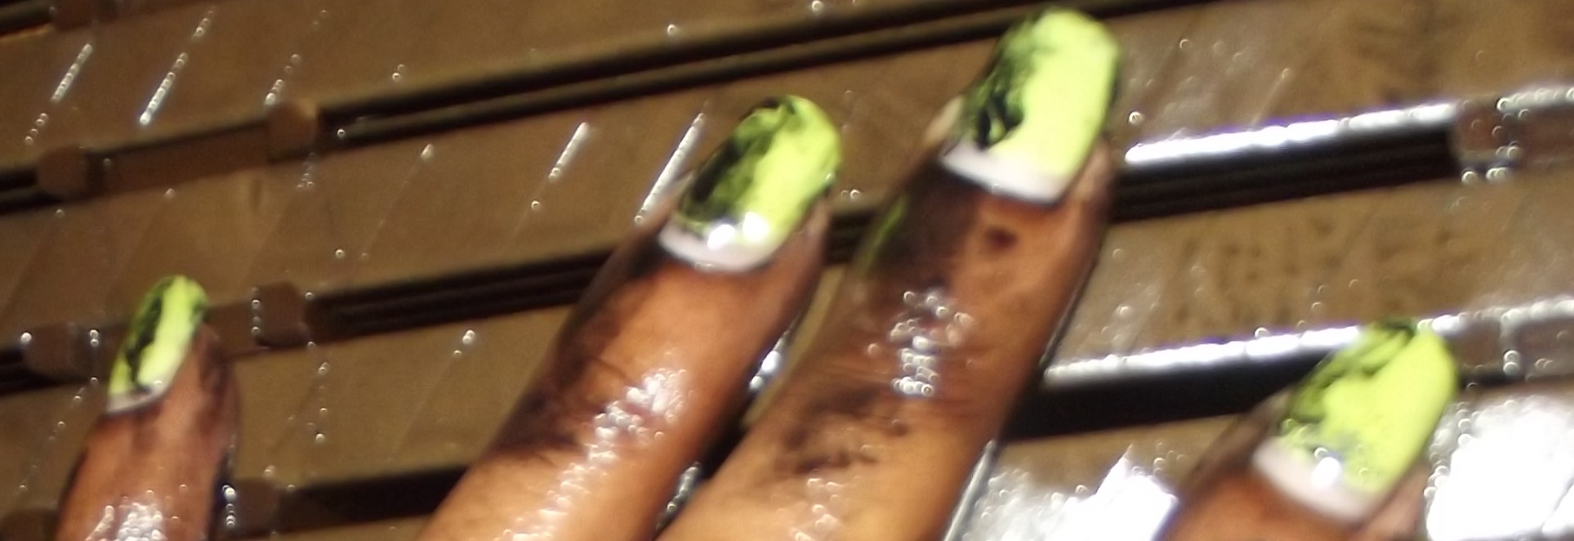
Why the need for Women in Energy Forums?
Normalize associating engineering/energy with women

Slide 4
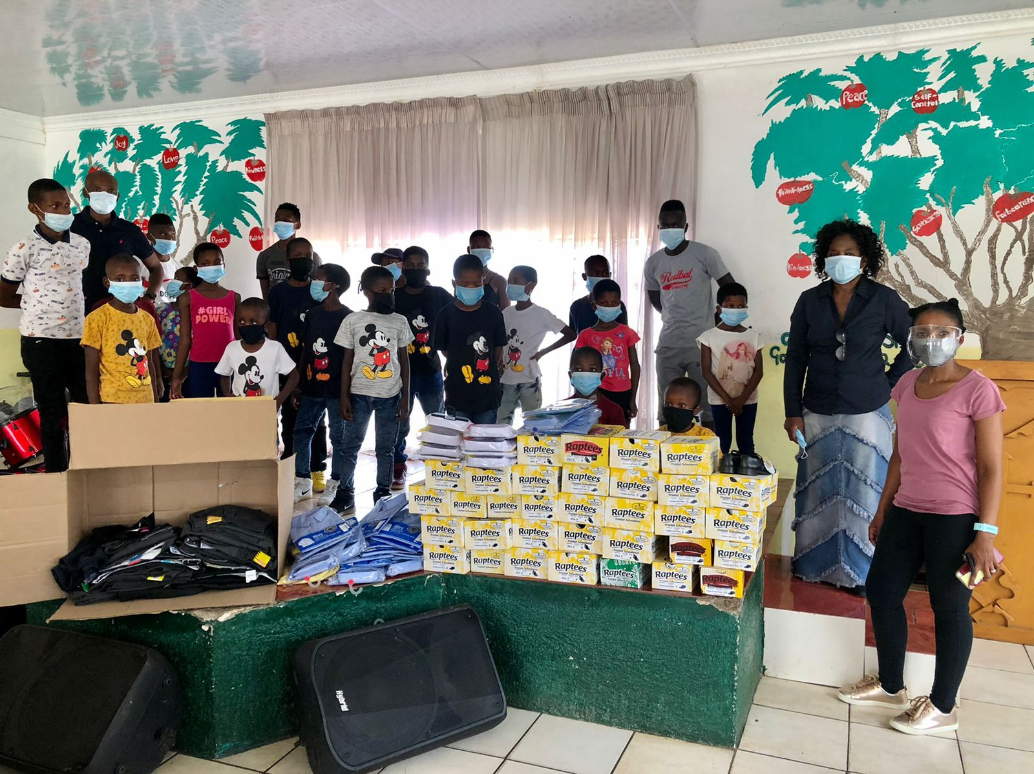
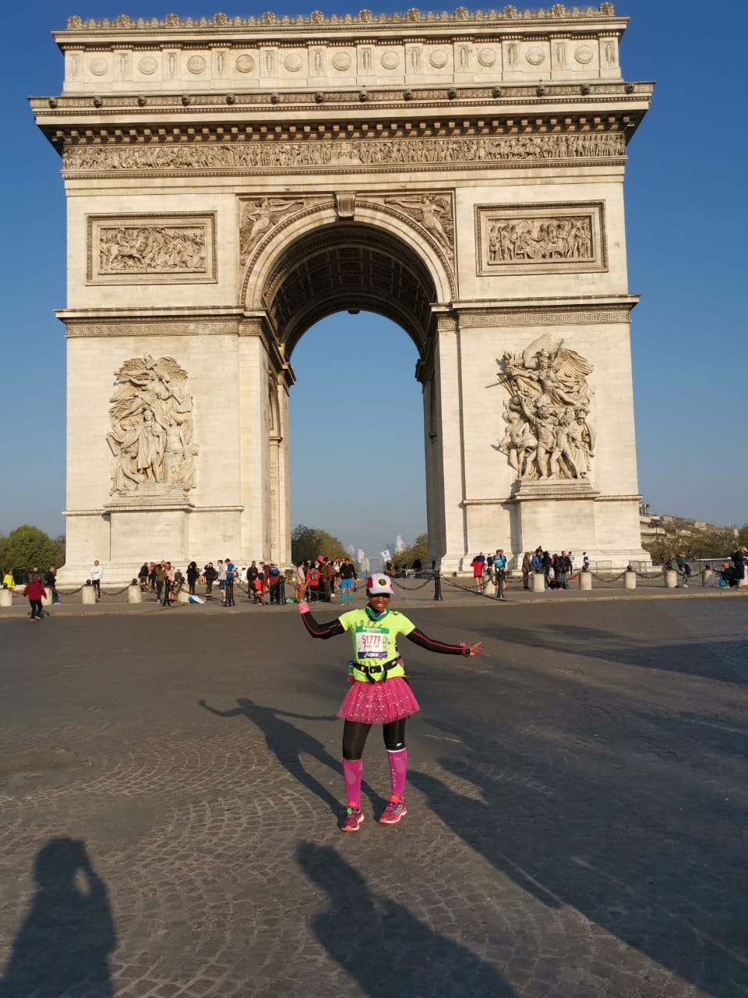
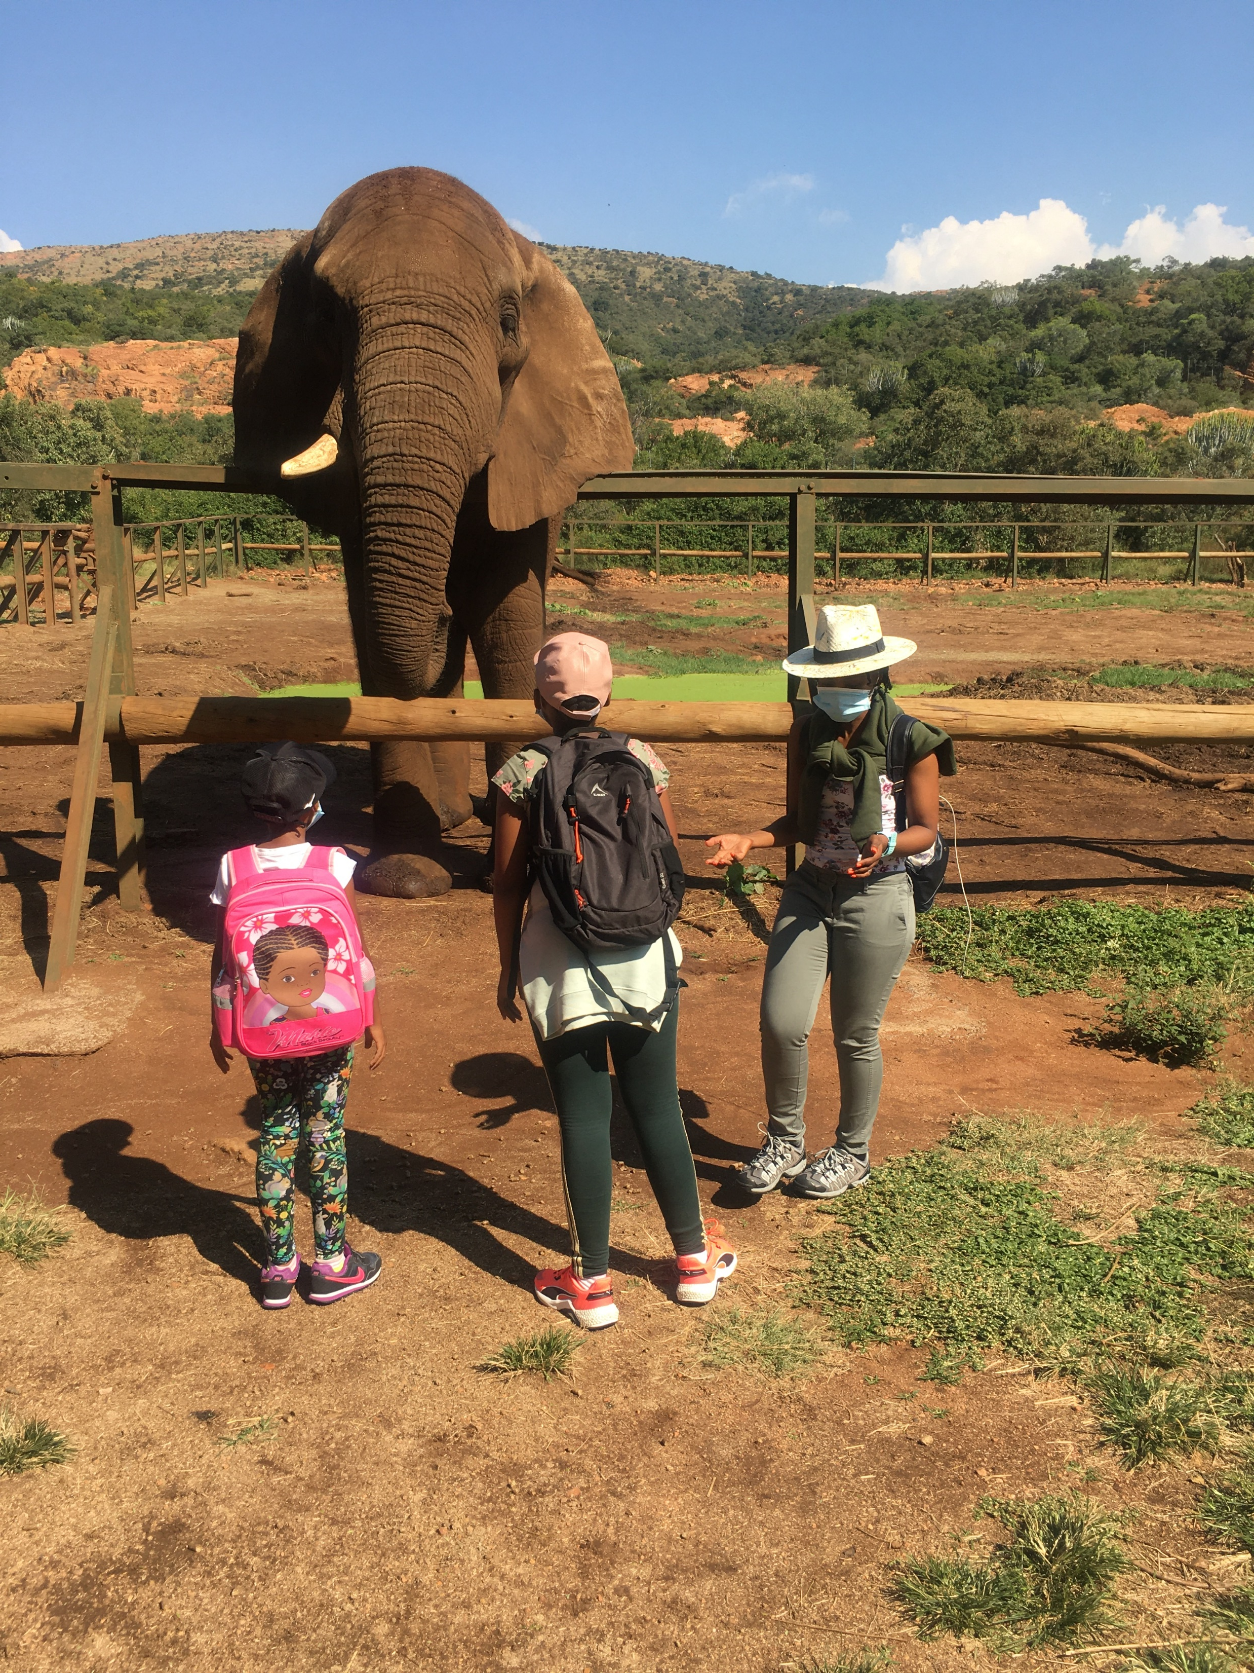
Why the need for Women in Energy Forums?
How about the socio-economic element? Fun?

Slide 5


Slide 6


https://www.stockfreeimages.com

Slide 7
WiE Forum Needs You
To give an opportunity to those different from the usual group at the table
To say yes to such opportunities - e.g Technical Bulletin reviews, publication reviews
To be the leader who recognizes unique talents and capitalize on them.
To be a mentor – attend meetings with someone different and ask for their contribution.
To give meaningful tasks – no matter how “small”.
For the benefit of not only women, but the organization and the engineering fraternity (growing membership and diversifying inputs)

Slide 8


