Slide 1
CIGRE Women in Energy Statistics
by Philippe ADAM, Secretary General

Slide 2
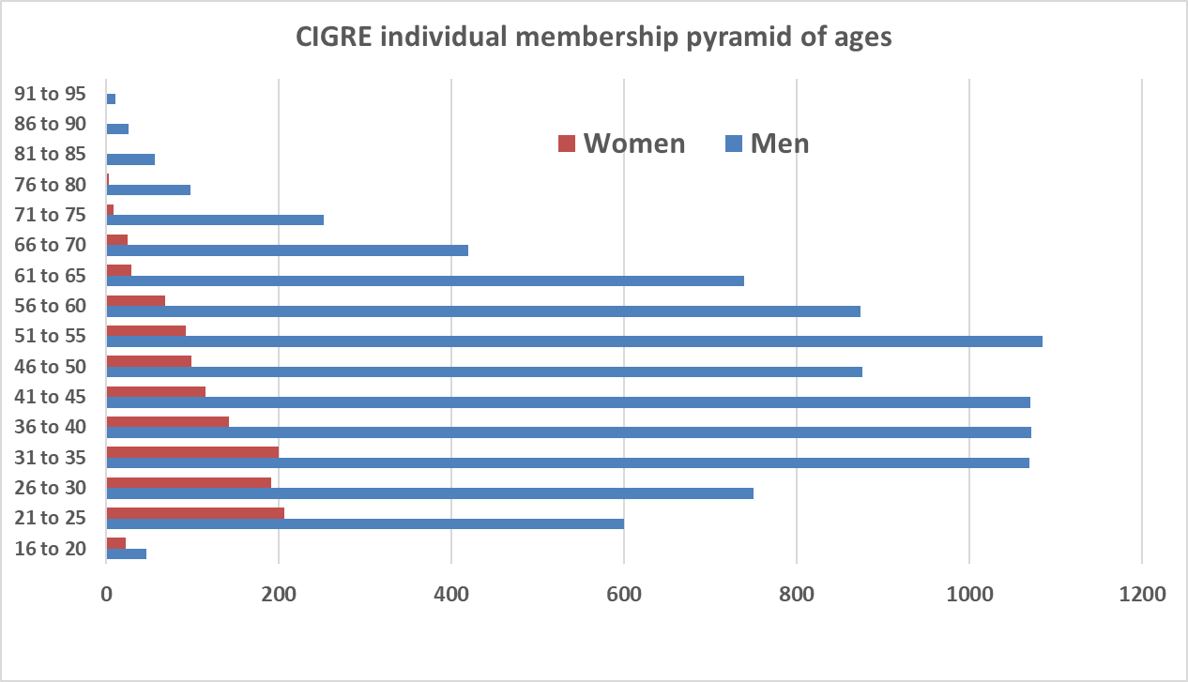
CIGRE membership pyramid of ages in August 2022

Slide 3
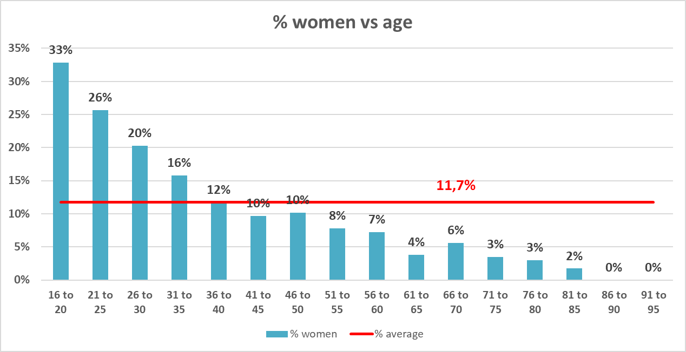
CIGRE membership – Share of women by age ranges

Slide 4
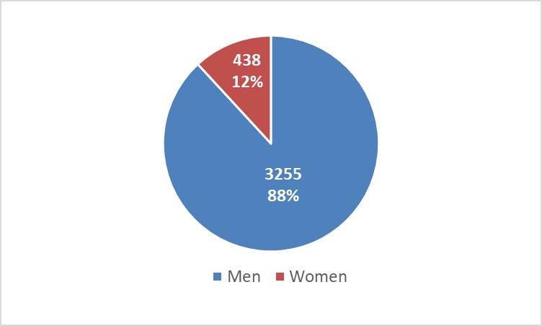
2022 Session delegates by gender

Slide 5
CIGRE governing bodies
Administrative Council
2018 : 5/59 (8%)
2020 : 5/61 (8%)
2022 : 4/61 (7%)
Steering Committee
2018 : 1/15 (7%)
2020 : 2/17 (12%)
2022 : 1/18 (5%)
Technical Council
2018 : 4/21 (19%)
2020 : 5/21 (24%)
2022 : 4/21 (19%)
Study Committee Chairs
2018 : 4/16 (25%)
2020 : 5/16 (31%)
2022 : 4/16 (25%)

Slide 6
CIGRE operational bodies
Study Committee Secretaries
2018 : 3/16 (19%)
2020 : 2/16 (13%)
2022 : 2/16 (13%)
Working Group Conveners
2018 : 23/240 (10%)
2020 : 18/242 (7%)
2022 : ---------
Working Group Members
2018 : 336/3986 (8%)
2020 : 395/4351 (9%)
2022 : 394/4346 (9%)

Slide 7
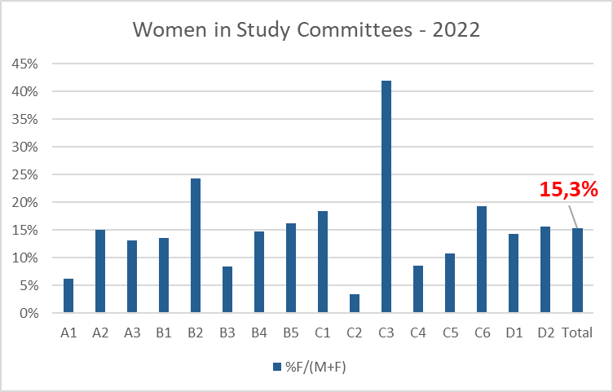
Women in CIGRE Study Committees

Slide 8
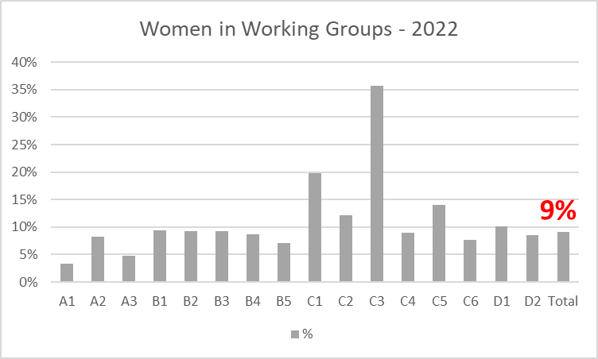
Women in Working Groups

Slide 9
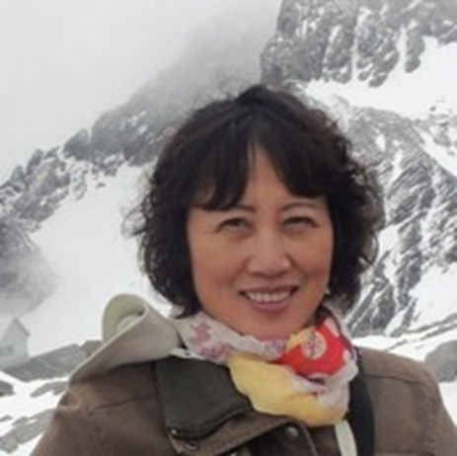
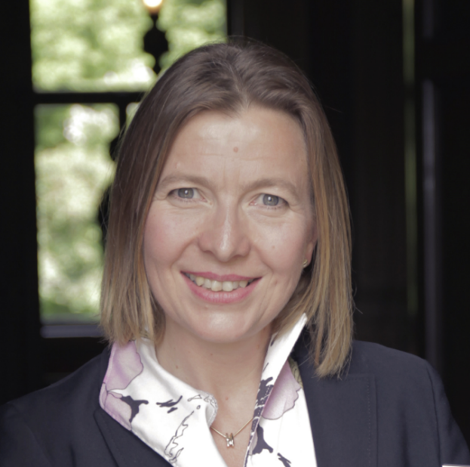


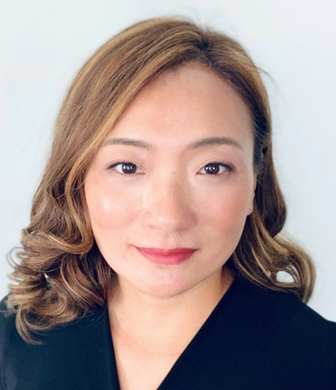
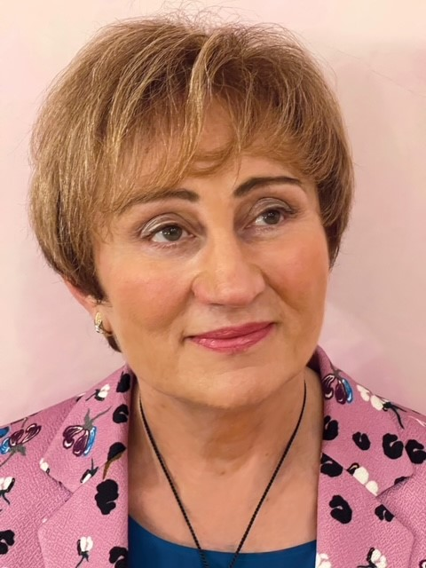
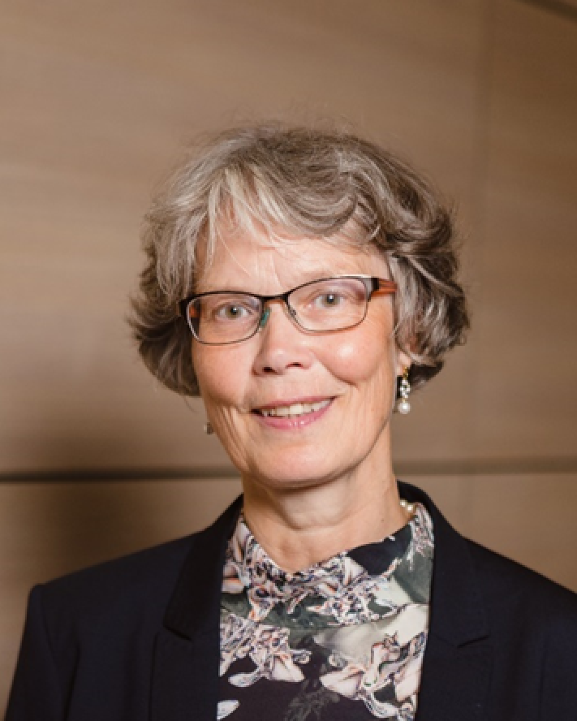
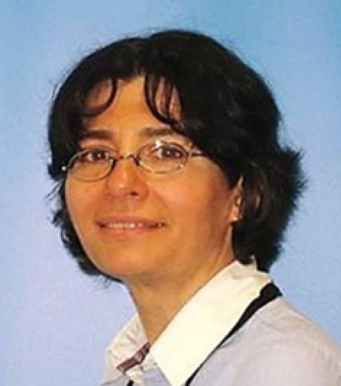
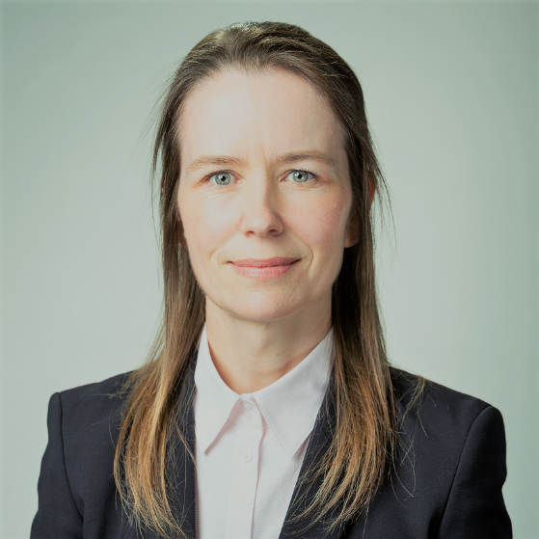
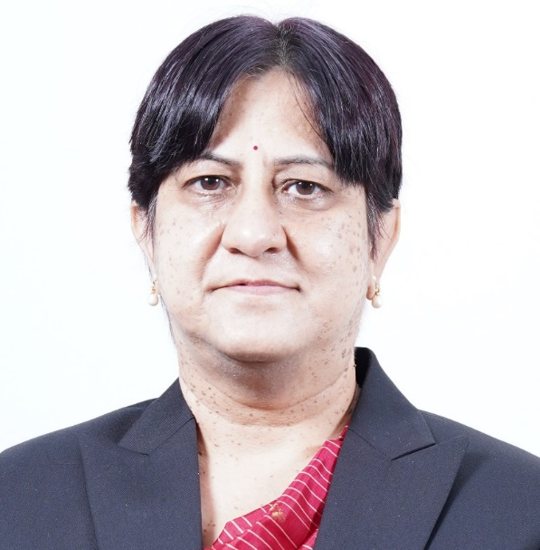
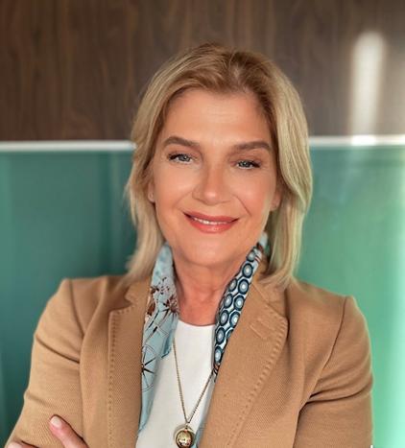
CIGRE WiE Awards recipients
Ruomei LI
Rannveig LØKEN
Amanda OLSON
Khayakazi DIOKA
Joanne HU
Olga SINENKO
Pranvera
DOBRUNA
KRYEZIU
Liisa HAARLA
Marta VAL
ESCUDERO
Genevieve
LIETZ
Renuka GERA
2020
2022

